Slide 1

ARGUING
with
MYSELF
SELF-SERVICE BI
from an
INFRASTRUCTURE
perspective
Alexander Arvidsson
@arcticdba

Slide 2











Slide 3


Slide 4
Look at SELF-SERVICE BI
Explore the IMPACT on
the infrastructure
Avoiding a governance
DISASTER

Slide 5
Self-service BI is
COMING

Slide 6
It might already be
HAPPENING

Slide 7
It is time to take back
CONTROL
and create new
OPPORTUNITIES

Slide 8




Principal Solutions Architect @ Atea
| Data Platform MVP | Speaker | Blogger |
| Podcaster | Pluralsight author |

Slide 10

64%
think self-service BI creates
significant competitive advantage.
71%
of the leaders in BI implementation say
that self-service BI tools tend to accelerate
learning and responsiveness.
57%
of the companies that took part in the
survey plan to accelerate investment in
distributed BI.
Forbes: Analytical Enablement: How leaders harness distributed business intelligence to drive breakthrough results

Slide 11
“BI here is always as
SLOW
as a broken watch”

Slide 12
“The process is
RIGID
as heck”

Slide 13
“We are always
DEPENDENT
on IT”

Slide 14
“POWER
to the users!”

Slide 15
“SHORTER
time-to-market!”

Slide 16
“More
UNEXPECTED
insights!”

Slide 17
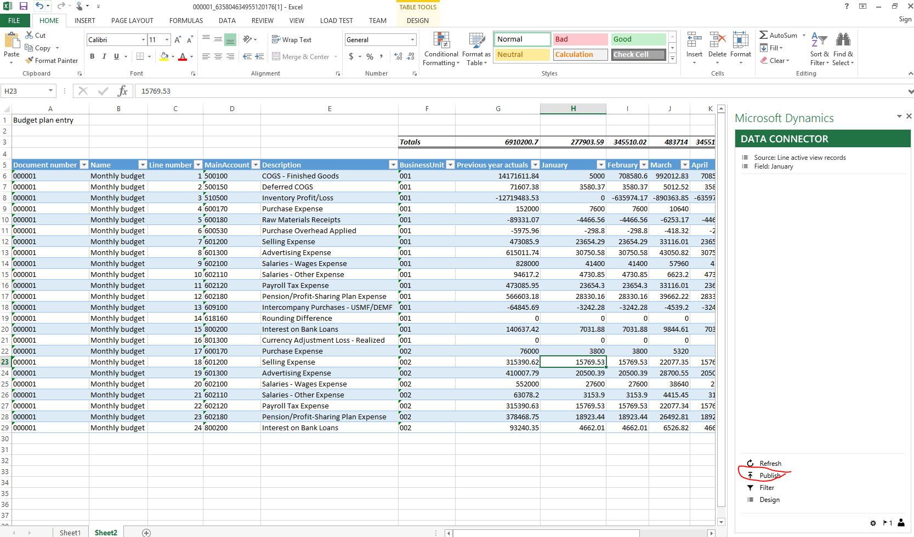

Slide 18
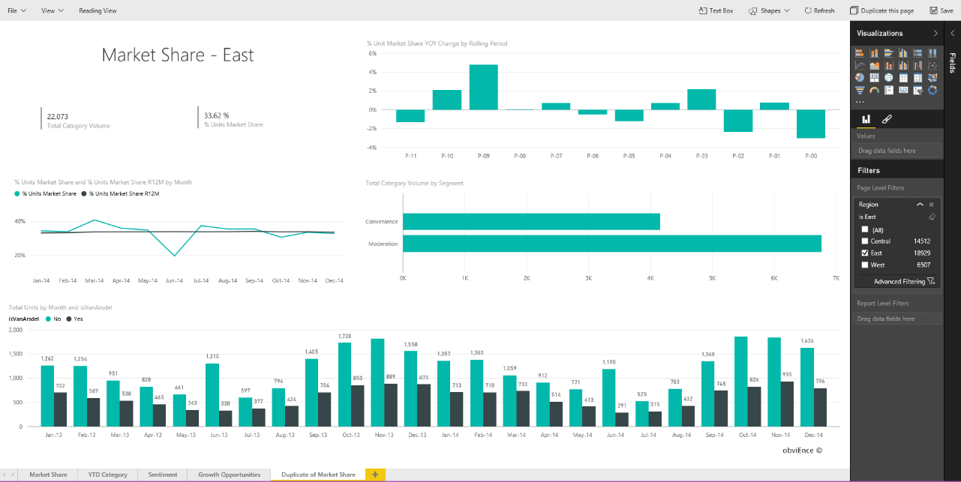

Slide 19

“…the boss
became
interested…”

Slide 20

“…new insights, more revenue, more profit…”

Slide 21

“…need for more data, deeper data…”

Slide 22

“…IT couldn’t quite shake
a feeling of doom…”

Slide 23

“…everyone wanted the shared data…”

Slide 24

“…much data was shared…”

Slide 25

“…analysts became rock stars, life was good…”

